Slide 1


SAP S/4HANA CDS, BTP Full Stack Training Day 9
Anubhav Oberoy

Slide 2

Day 9
Add custom UI to Fiori Elements
Understanding Class pools
--break
Behavior Definition
Build CURD App
Enable Draft
--break
Behavior pool
Introduction to EML
Adding Actions
Provide determinations and validations
Side Effects
Authorizations
Notes:
https://unsplash.com/photos/CPs2X8JYmS8

Slide 3

Local Types/Classes in ABAP with Global Classes
Local Types for Global Classes - Within class pools, as in virtually any other ABAP program, data types, local interfaces, and local classes can be defined to ensure a better structure of the implementation of the global class.
More number of classes will cause confusion and over-modularization increase the complexity of our design
More number of global classes, will increase the chance of our code being exposed to reports/classes which we may want to use only a private
Allow a modularized way of designing app but still keeping our code in a single contain, a good balance between number of classes v.s modularization.
At times we need so many classes for different purpose with very limited no of methods. 2 meh. + 20 classes, Create a class pool would be a good options.

Slide 4
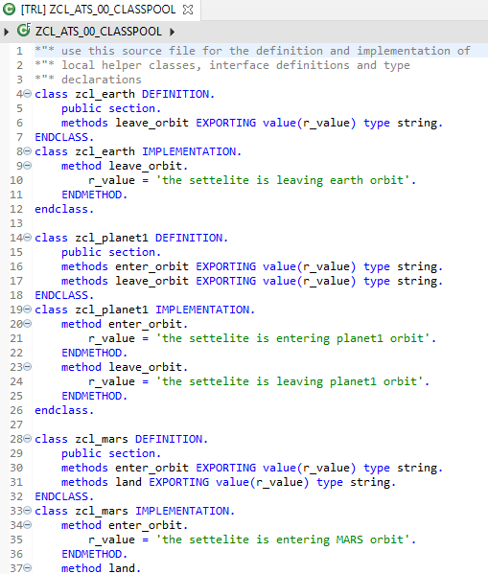
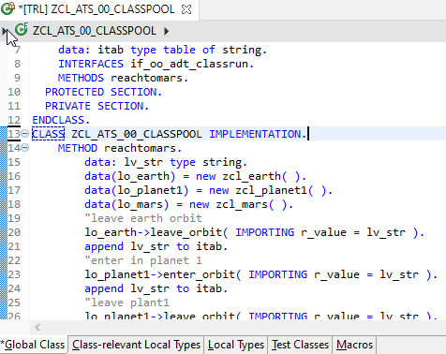
Implementing Class Pool Concept
Global Class
Exercise
Class Pool Code
Local Types/Class

Slide 5
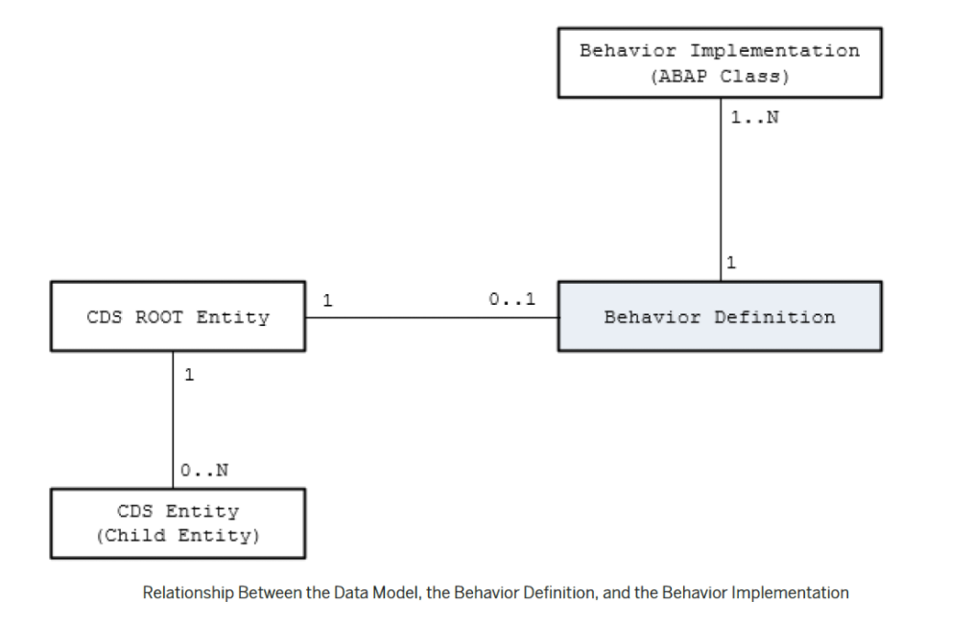
Behavior Definition
A business object behavior definition (behavior definition for short) is an ABAP Repository object that describes the behavior of a business object in the context of the ABAP RESTful programming model.
A behavior definition is defined using the Behavior Definition Language (BDL) and comprises capabilities and modelling aspects of the business object node or nodes, for example the supported operations (such as create, update, and delete actions) or the definition of lock dependencies between the parent and child nodes.
A behavior definition always refers to a CDS data model. This reference results from the name equality with the root entity. This means that a CDS data model must always exist before the behavior definition is created.
A behavior definition relies directly on the CDS root entity.
One behavior definition refers exactly to one root entity and one CDS root entity has a maximum of one behavior definition (a 0..1 relationship), which also handles all associated (child) entities.
The implementation of a behavior definition can be done in a single ABAP class (behavior pool) or can be split between an arbitrary set of ABAP classes (behavior pools). You can assign any number of behavior pools to a behavior definition (a 1: n relationship).

Slide 6
Behavior Pool
The transactional behavior of a business object in the context of the current programming model is implemented in a global ABAP class or classes. These special classes are dedicated only to implementing the business object’s behavior and are called behavior pools.
the implementation of a behavior definition can be done in one class or split across an arbitrary set of ABAP classes.
You can assign any number of behavior classes to a behavior definition (a 1: n relationship). Within a single global class, you can define multiple local classes that handle the business object’s behavior.
The global class is just a container and is basically empty while the actual behavior logic is implemented in local classes.
Local class 1 for Entities
Behavior Definition
Class Pool
Local class 2 for Entities
Local class 3 for Entities

Slide 7
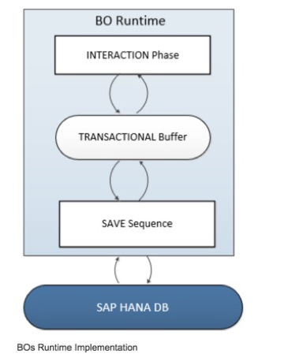
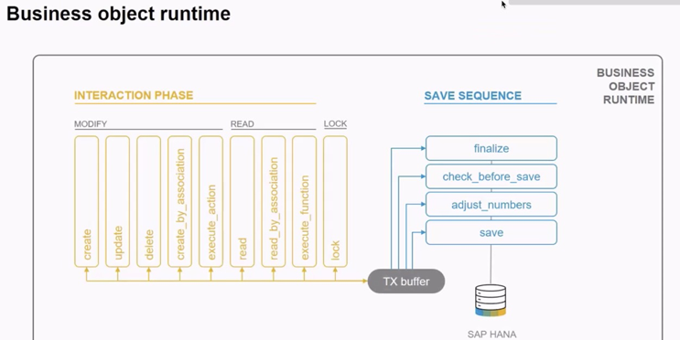
Business Object’s Runtime Implementation
The business object runtime mainly consists of two parts: The first part is the interaction phase where a consumer calls the business object operations to change data and read instances with or without the transactional changes. The business object runtime keeps the changes in its internal transactional buffer which represents the state of the instance data. This transactional buffer is always required for a business object. After all changes were performed, the data can be persisted. This is realized with the save sequence.

Slide 8
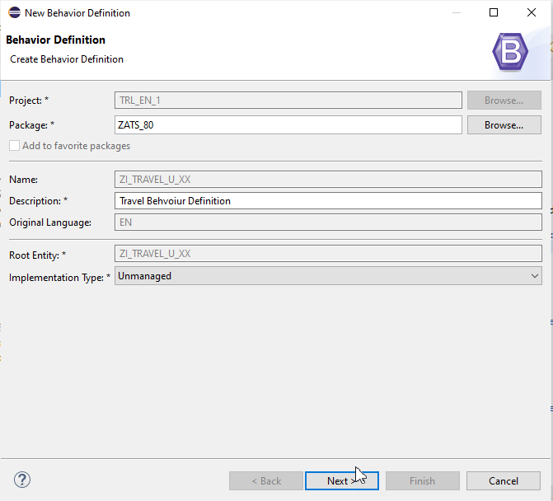
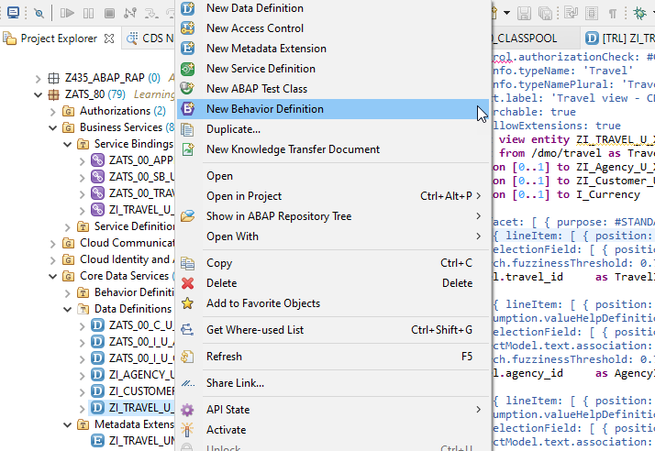
Create of Behavior Definition

Slide 9
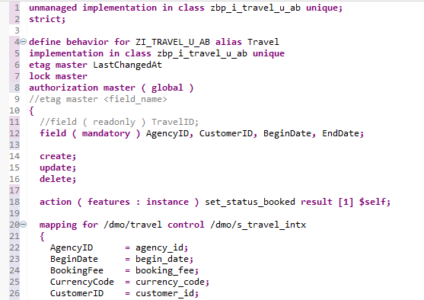
Implementing Behavior Definition
Exercise
Behavior Definition Code

Slide 10
Fiori App
OData
RAP
B-IMP
Legacy Code
post
Agency customer id
Start date
End date
Create
Create IMPORT
Entities (%cid)
Write to TB
messages
save
Save to DB
cleanup

Slide 11
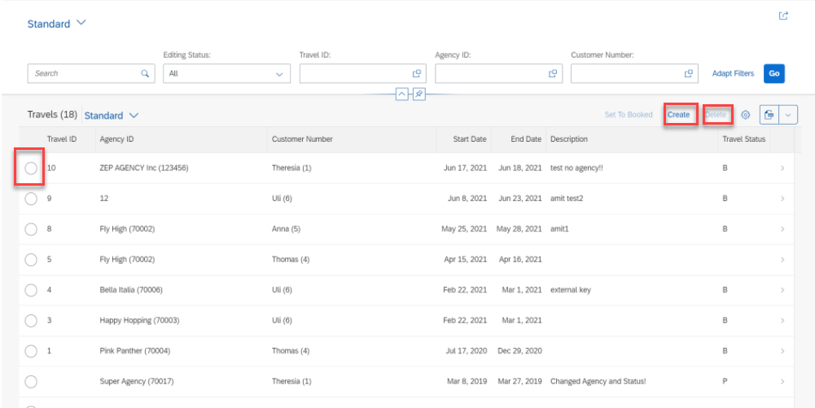
Implementing Create, Update and Delete
For the Functionality of Create ,Update & Delete we Implement the Code in Behavior Definition Class.
Step 1: Click Create Button.

Slide 12
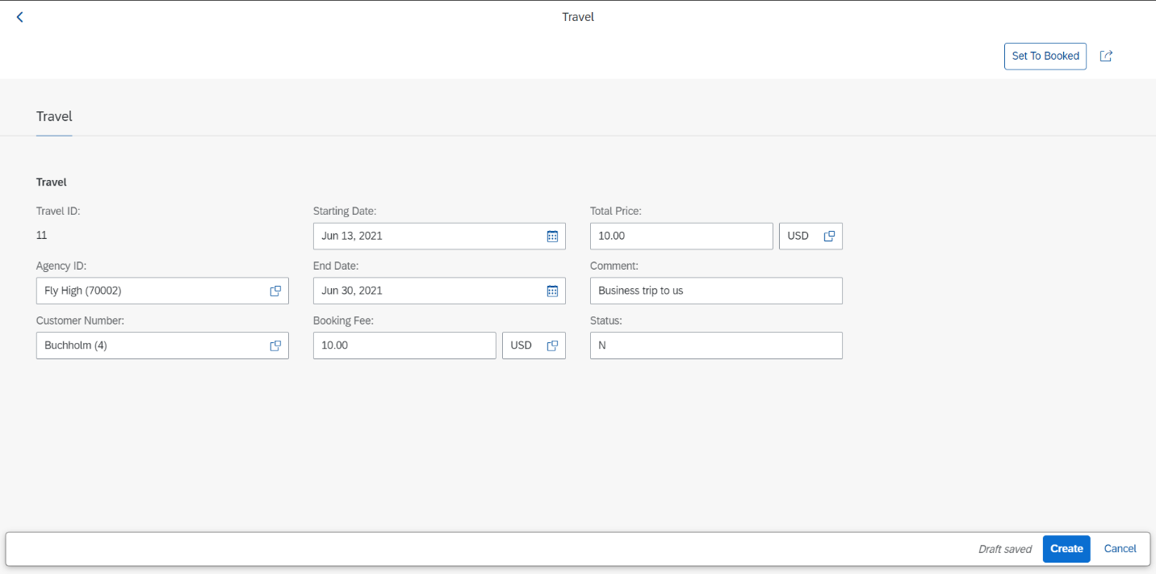
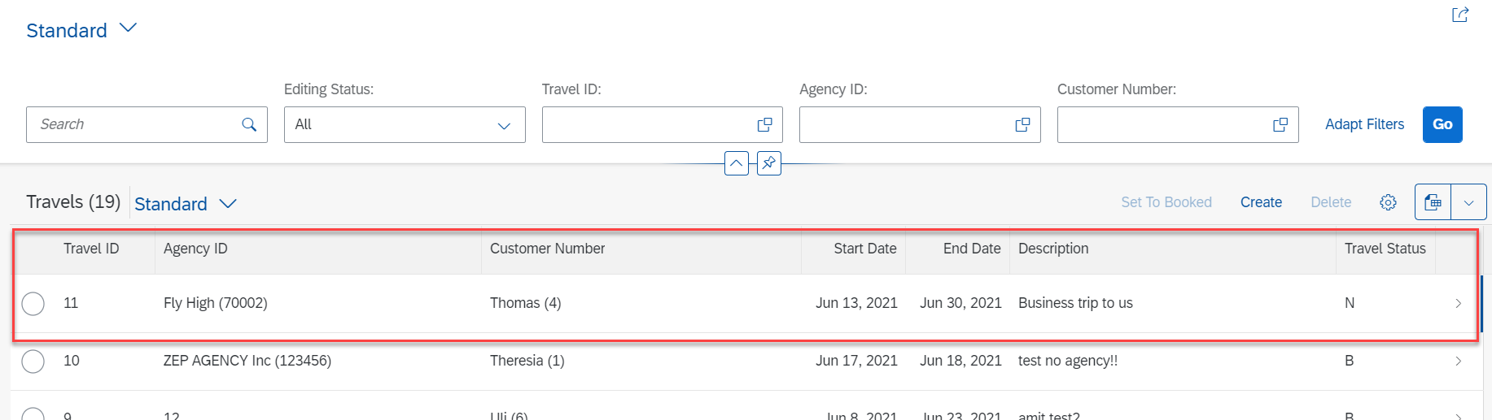
Implementing Create
Step 2: Fill all Correct Entries and Click on Create Button.

Slide 13
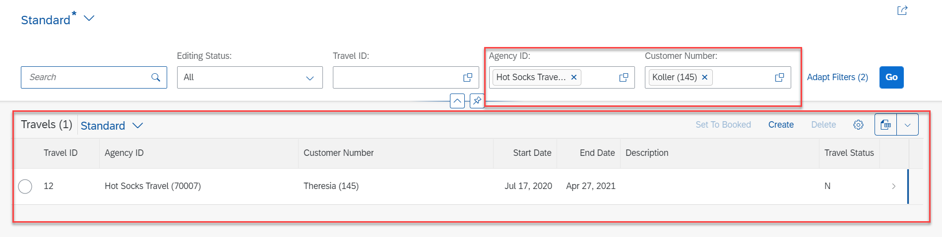
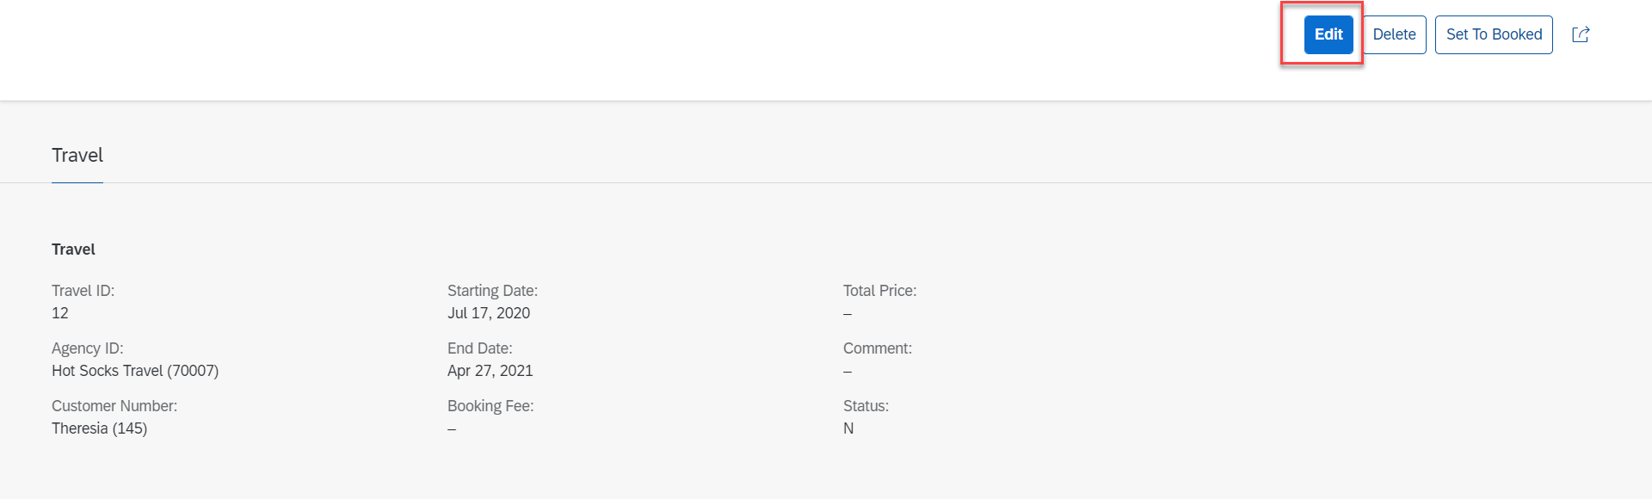
Implementing Update
Step 3: Select a Radio Button and Click Edit Option for Update.

Slide 14
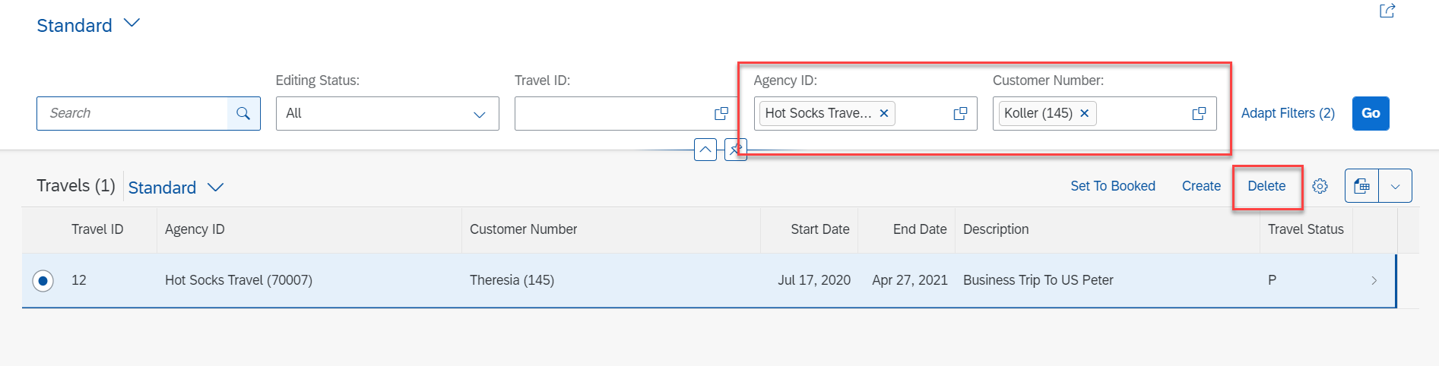
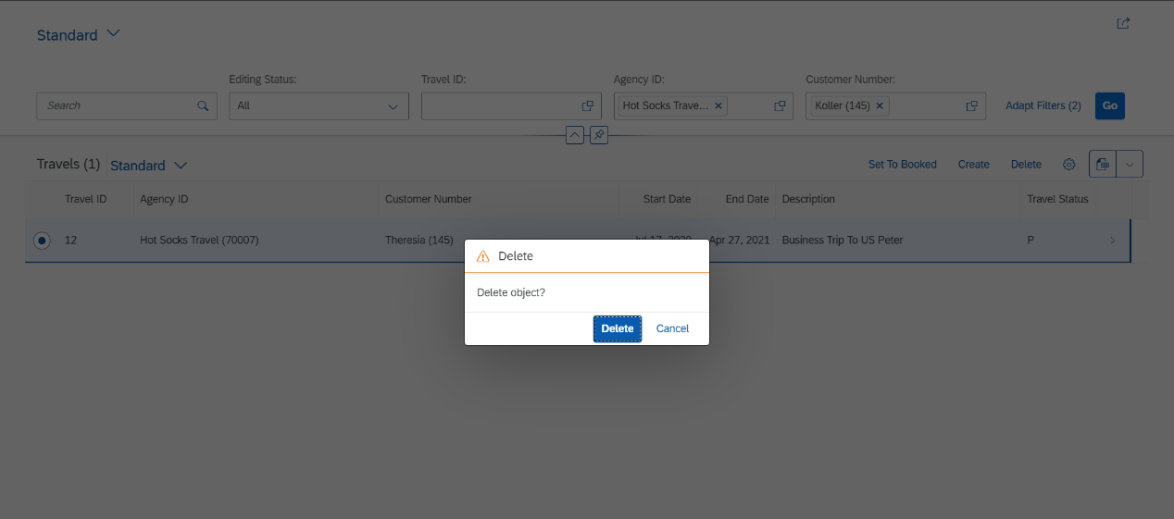
Implementing Delete
Step 4: Select a Radio Button and Click on Delete Button.

Slide 15
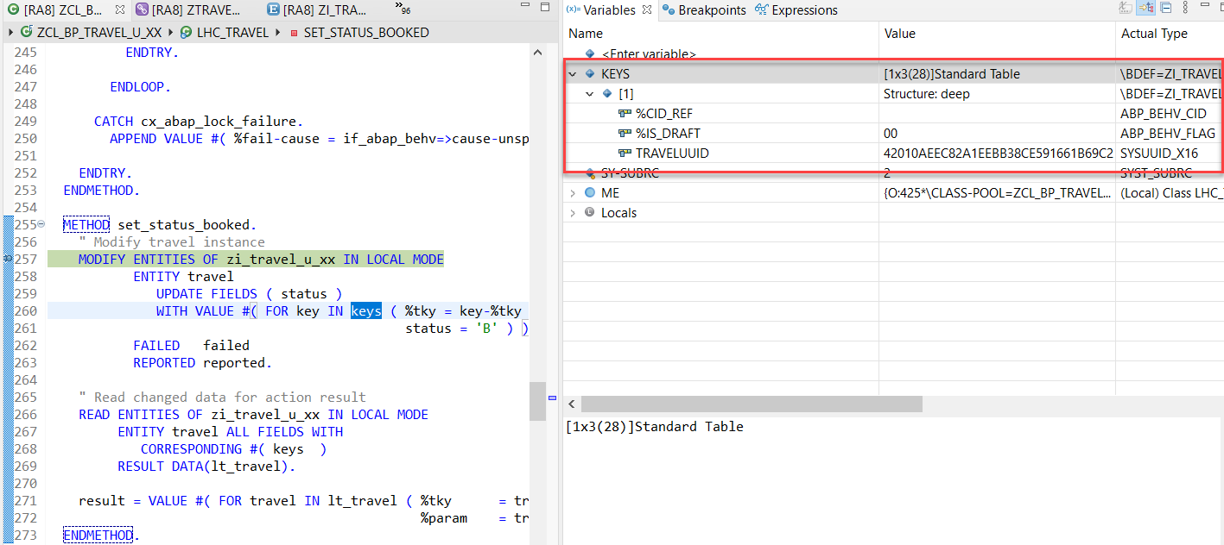
Action Implementation
“Actions” are addition operations in addition to CRUD operations. Are the operations which are non-standard for a business object
Below steps describes the implementation of an action related to the travel instances. Using this action, the end user should be able to change the status of travel processing.
Adding a Type Definition for Import and Export Parameters Required for the Action SET_STATUS_BOOKED
Implementing the Action Handling.

Slide 16
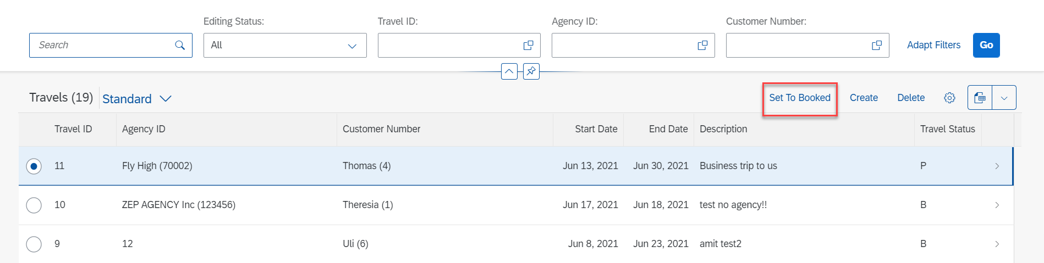
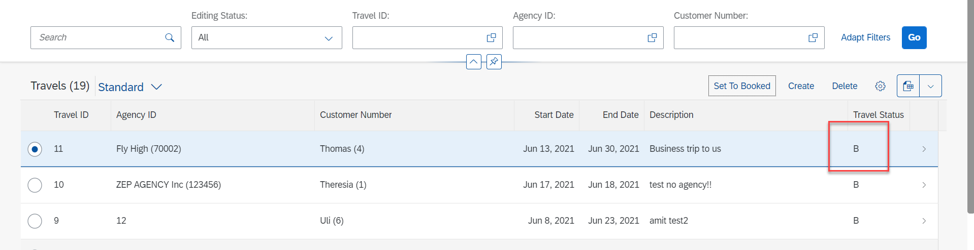
Action Implementation
Select Radio Button and Click on Set To Booked & Travel Status Change to Book (B)

Slide 17
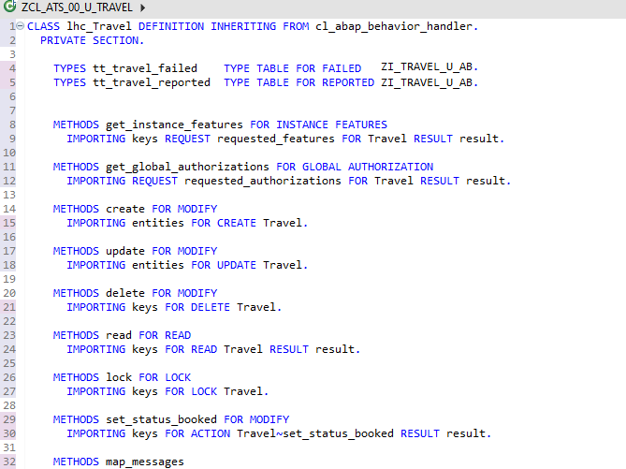
Behavior Pool Logic
Exercise
Behavior Pool Logic

Slide 18
What is EML ?
The Entity Manipulation Language (EML) is a part of the ABAP language that enables access to RAP business objects. Because the consumption of business objects via the OData protocol requires a Fiori UI or a web API, EML enables a type-safe access to business objects directly by using ABAP.
A Business Object in RESTful ABAP is consists of multiple Entities. This is a entity composition tree with one entity acting as a root. EML is part of the ABAP language and used in context of RESTful ABAP to control the BO behavior (create, read, update, delete).
We can use the EML in ABAP to test our BO. We can call the BO using EMP from ABAP program in 2 ways
01
Standard (Statically)
Generically (Dynamic) framework.
02

Slide 19
Syntax of EML
The EML provides us 3 important access statements for Data Manipulation using BO( Business Object ).
01
Perform the CUD ( Create ,Update ,Delete on BO
MODIFY ENTITIES OF RootEntityName
ENTITY EntityAliasName
[ CREATE FROM it_instance_c ]
[ UPDATE FROM it_instance_u ]
[ DELETE FROM it_instance_d ]
[ CREATE BY \AssociationName FROM it_instance_cba ]
[ RESULT et_result_tab ] [ FAILED failed ] [ REPORTED response ] [ MAPPED mapped ]
02
Commit Entities
Will actually persist the changes in the DB from transaction buffer. Any modify operation that are executed within behavior pool or by ABAP program are not causing any DB change because they are applied on transaction Buffer and this buffer content will disappear when ABAP session ends. So if we want the changes to be passed to SAVE SEQUENCE and persisted, we will use the COMMIT ENTITIES statement.
finalize ( )
check_before_save( )
Adjust_numbers( )
Save( )

Slide 20
Syntax of EML
03
Read the Data
All operations that do not need to change the data of an entity are carried out by READ Data.
There 2 types of Read
Read Entity by Key
Read Access to child (association) by parent key
Read Statement always returns the RESULT and you must specify target variable. We can also read the associated entity data using BY \asso_name FROM it_table syntax.
The result of associated data with come in another internal table LINK tab_name, it will always contain the key value pair.
READ ENTITIES OF RootEntityName
ENTITY EntityAlias FROM it_read_condition
RESULT et_result
BY \asso_name FROM it_read_rba
RESULT et_res_rba
LINK et_link_keys
ENTITY EntityAlias FROM it_ins_2…. [ FAILED failed ] [REPORTED reported]

Slide 21

Rule for EML
In addition to the data we also have a compiler generated field in input and output results called %control, this field is responsible to inform the RESTful framework that, which are all the fields we would like to send to DB while creation or update while updating. Also while read we can specify the same to avoid reading everything.
We can also see the complete BO structure in BO Explorer using keyboard shortcut :-
Alt+Shift+W

Slide 22
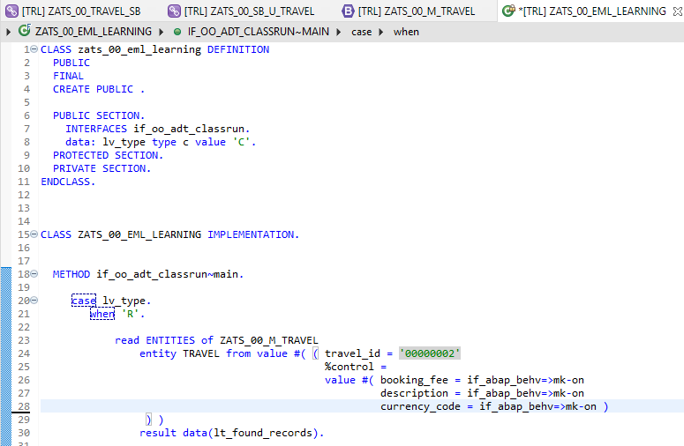
Implementing EML
Exercise
ZATS_00_EML_Learning

Slide 23
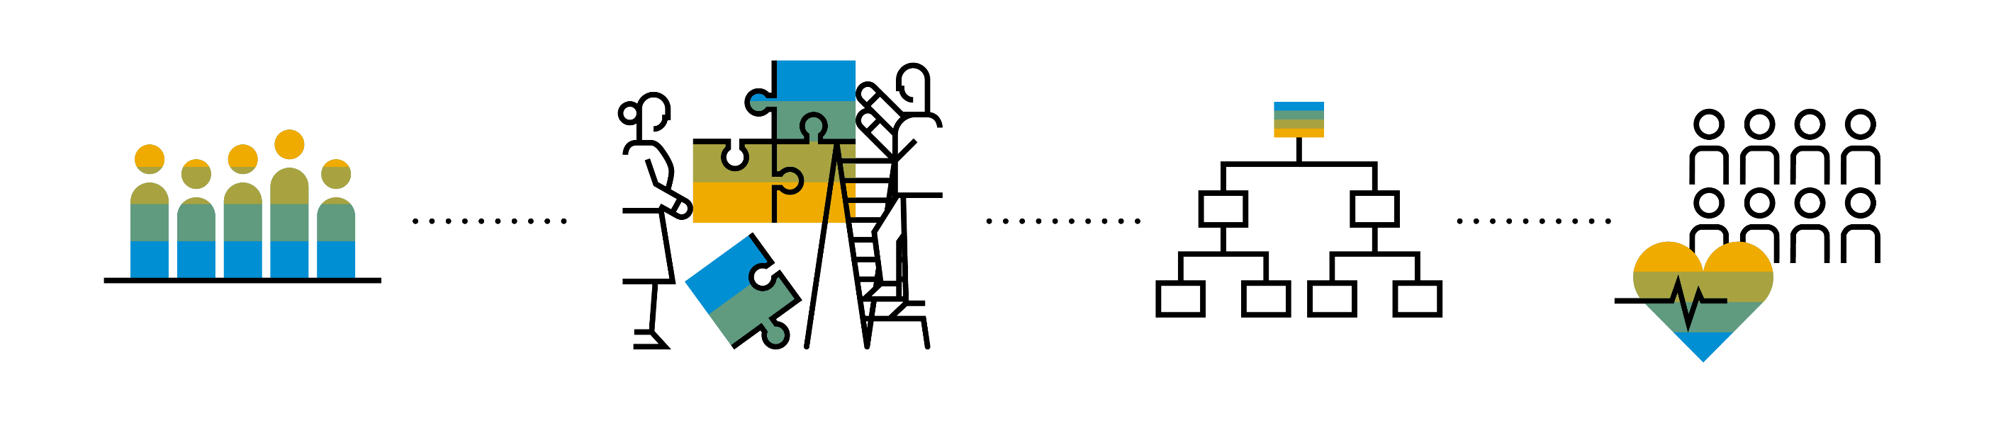
Introduction to Managed Scenario
Let us consider we have been given a green field and asked us to develop a villa from scratch with our own customization. So, what steps will be involved in it? We need to design the floor-plan of the villa, the sections we want to include in the house like pool area, a garden, a jogging track etc. And we will proceed with selecting materials, selecting vendors, enforcing conciliation and orders and many more steps. Similarly, the RAP’s managed scenario provides the greenfield development for our business object.
In the managed scenario, the implementations of behavioral elements like Create/Update/Delete are managed by the RAP framework itself. However, to implement complex logic like validations, determination or some sort of actions (Submit, Approval, Reject etc.) on the business entity, you need to add the ABAP logic for it in implementing classes.

Slide 24



Use Case for Managed Scenario
I am working as a ABAP on Cloud developer for one of the travel planner agency, which has just taken the BTP subscription. They want me to create 2 fiori apps for the travel industry
Processor Application
Approver Application
MakeMyTrip.com
Source → Destination
Start → End Date
How many
Travel Itinerary
Travel Request which has multiple Bookings
Create a travel request and add bookings with all the properties changeable
Updates booking fees and description and provide approvals
Processor
Approver

Slide 25

Steps for Build Use Case
Fiori App for Processor
Fiori App for Approver
Service Def and Binding
Service Def and Binding
CDS Data Model
CDS Projection for Processor @UI
CDS Data Model
CDS Data Model
CDS Projection for Approve @UI
Introduction
1..1
Behavior Def
Projection (processor)
Behavior definition
Behavior definition
Behavior Def
Projection (approver)
Behavior definition
Behavior Implement (pool)

Slide 26
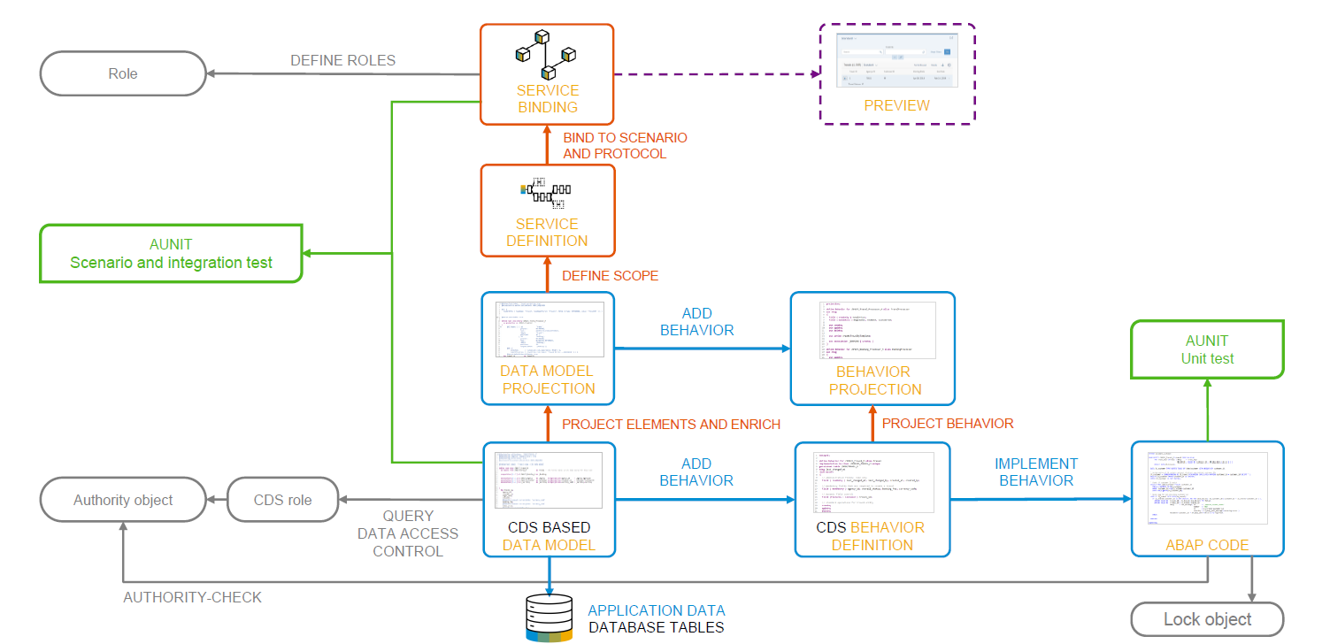
Development flow

Slide 27
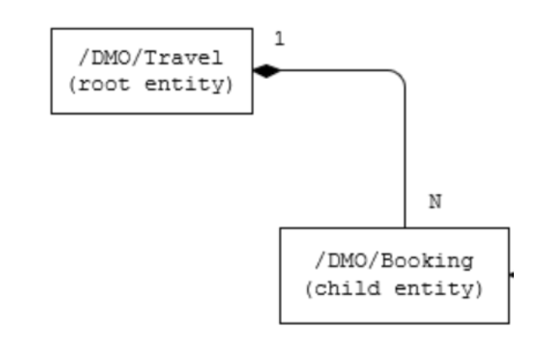
Our new Business Object
From a structural point of view, a business object consists of a tree of entities that are linked by compositions. Every entity in this composition tree is an element that is modeled with a CDS entity. For our demo travel booking scenario, we will implement a 2-level hierarchy composition tree.
As depicted in the figure below, the 2-tier entity hierarchy for managing transactional data in our scenario consists of the following editable entities, with a 1: N cardinality on each level:
Travel
Booking
i.e. each travel instance has 0..N bookings The figure below shows the composition relationship between the travel and the (flight) booking entities, where the travel entity represents the root of the data model.

Slide 28
Calculator
3rd – 6th
Addition, subtraction
Calculator
7 and above
Addition, multiplication, division
1 2 3
4 5 6
7 8 9
0 $
1 2 3
4 5 6
7 8 9
0 $
+
/
+
-
*
Projection
Projection
1 2 3
4 5 6
7 8 9
0 $
/
+
*
-

Slide 29
Our Demo Scenario
This demo scenario uses two projections with a different service scope. The resulting apps represent two role-based approaches to managing travels.
One business object projection uses the BO characteristics and the operations that are relevant for processing travel data. This resulting UI service serves the role of a data processor. The responsible person can enter the information about travels, bookings into the role-based app for processing travel data. This person needs functionality to create, update and delete entries on all three tiers of the business object. In addition, the action CreateByTravelTemplate is designed to facilitate the creation of new travel entries. The instance-bound action reads the values of the selected entry and creates a new entry based on these values with some deviations for the TravelID and the travel dates.
The other business object projection is the basis for a UI service that contains the functionality that is relevant for an approver. Imagine a person, maybe a manager of a travel agency, that approves the data that was entered by the processor. That means, this person sees the travel information and the corresponding booking data. Based on this data, the approver can either accept or reject the travel. For a minimal scope of fields in the travel entity the approver is enabled to edit the values, for example the BookingFee or the Description. The information about bookings is set to read-only for the approver. The approver is not allowed to change the fields of the booking entity.
Processor
Approver

Slide 30
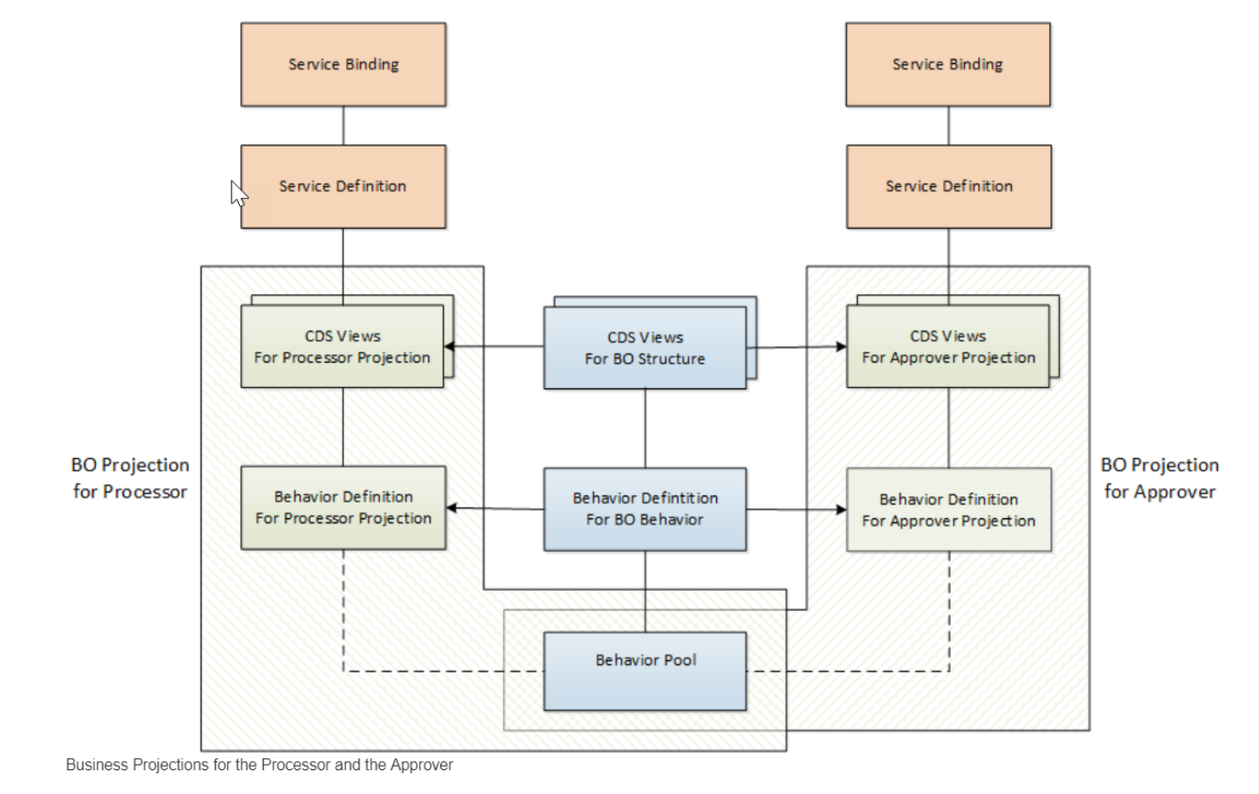
Projections

Slide 31

Title
content
www.anubhavtrainings.com

Slide 32

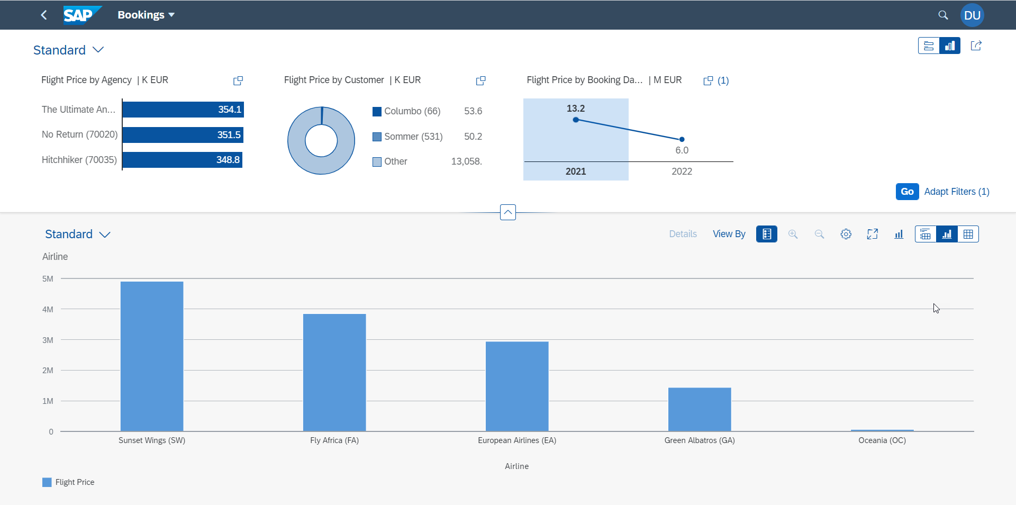
Analytic List Page
A ALP is used to display analytics as well as line item data in list. We can analyze data distribution across multiple dimensions for our measures. It also allows along with filter bar a special types of filter called visual filter.
www.anubhavtrainings.com

Slide 33

Questions?

Slide 34

Thank you
Anubhav.abap@gmail.com
contact@anubhavtrainings.com
+91 84484 54549
www.anubhavtrainings.com

